Slide 1
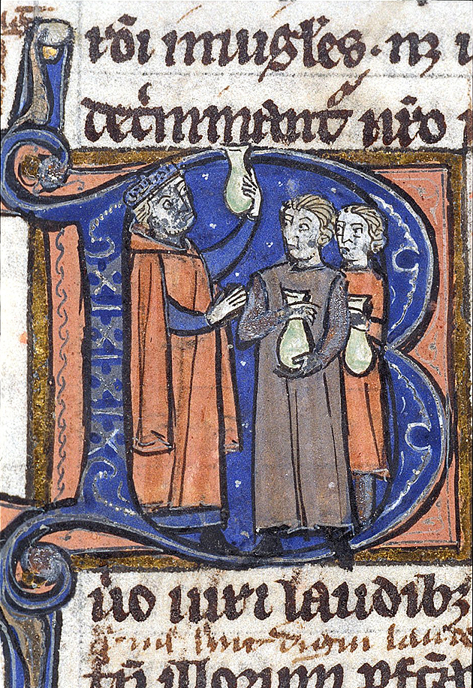
The Medical Response
In this image from around 1300, a medieval medical professor teaches two medical students how to examine the urine of a patient. Then as now, this was an important and basic test but what the doctor hoped to learn was very different.
This image, like others we’ve seen, is an incipit, this time in the letter B.
From the British Library collection, Harley 3140 f. 32v. C. 1300.
Notes:
http://www.bl.uk/learning/images/medieval/medicine/large14883.html

Slide 2
Questions to Consider in Module 5
How did medieval people understand all of this destruction? One way to make sense of a devastating disease, naturally, is through existing theories about the world. That is exactly what people did. The most educated minds of the medieval world worked to understand the plague in a way that was in line with existing physical and metaphysical understandings. The conclusions medieval physicians and theologians might not seem correct to us but they were how medieval people thought about the plague. In order to understand their response, we need to understand their thought processes.
Dols’ chapter is a comparison between the western Christian and Muslim reactions to the plague. What argument is he making, overall, and what are some difference he notes in the response of the two religious groups?
Where do Christian and Muslim experts agree in their understanding of the plague and where do they differ?
Where do religious and medical experts agree or disagree?
What were medieval theories governing medicine and how did those factor into responses to the plague?

Slide 3
The Medieval Worldview
Medieval people—Christian, Jewish, and Muslim—believed that God was the cause of all things, including disease.
They also had a sophisticated theory of science and medicine (even if today we do not recognize their theories as correct).
Medicine and theology—science and religion—were not at all seen as contradictory by learned medieval people.
For reasons that will be explained below, fundamental medical theory was the same in Christian, Muslim, and Jewish circles.

Slide 4
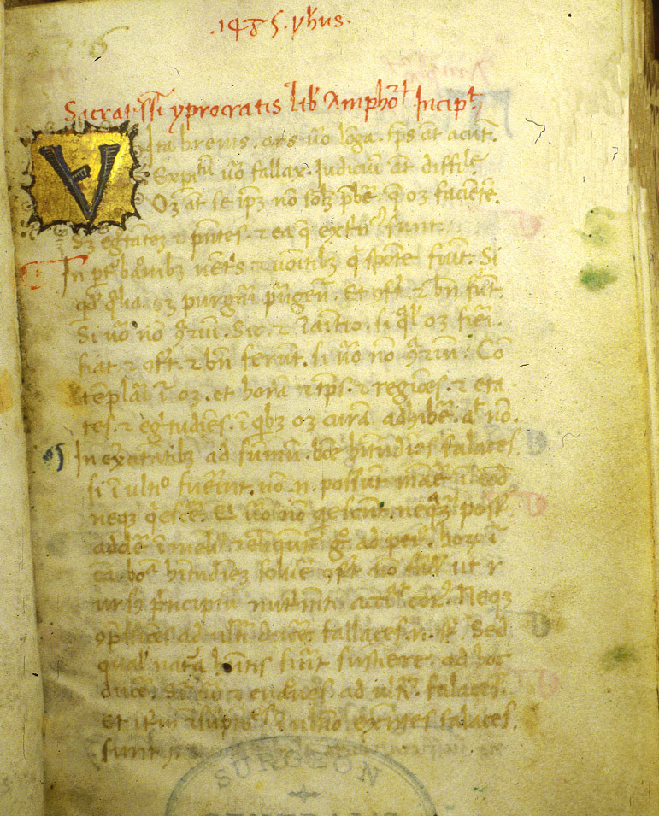
Passing down knowledge
Medieval medical theory derived from Greek and Roman traditions.
Early Christians preserved & copied ancient texts.
To a much greater extent, Muslims preserved them, translated into Arabic, and expanded on ancient medical knowledge.
Medical knowledge passed back to Christian scholars directly from Muslims and also through Jews, who worked alongside both Muslims and Christian.
Much of this knowledge came through Spain, where there was a much higher degree of contact between Christians, Muslims, and Jews.
Page from a medieval medical text making reference to Hippocrates (Greek, d. 377BC), Galen (Greek living in the Roman Empire, d. 200AD) and Avicenna (Muslim, d. 1037AD). Meant to be used by doctors at the patient’s bedside. Created in Italy in the 1480s.
For more like this, visit https://www.nlm.nih.gov/hmd/medieval/articella.html
Notes:
http://www.nlm.nih.gov/hmd/medieval/articella.html

Slide 5
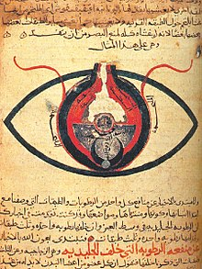
Medieval Islamic Medicine
In the Middle Ages, one of the world capitals of medical knowledge was Baghdad.
Medicine in the medieval Islamic world was very advanced; doctors preformed cataract surgery (on the eyeball)! when Vikings were raiding Europe!
Anatomy of the Eye by the Iraqi al-Mutadibih, who lived in the 1000s. This copy is from around 1200.

Slide 6
Humoral Theory
Humoral Theory was the guiding philosophy of medieval medicine.
All of the substances in the universe were created of 4 elements (the medieval equivalent of our Periodic Table of the Elements)
The body was made of 4 humors, each corresponding with one element.
The humors correspond with bodily fluids, but they also correspond with personality characteristics.
Humor | Bodily Fluid | Body Part | Element
Sanguine | Blood | Liver | air
Choleric | Yellow Bile | Spleen | fire
Phlegmatic | Phlegm | Lungs | water
Melancholic | Black Bile | Gall Bladder | earth

Slide 7
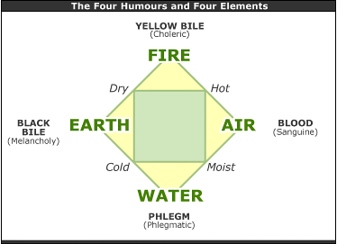
It’s easier to think about this in a diagram.
You can find numerous diagrams online, but here are two examples, one modern:

Slide 8
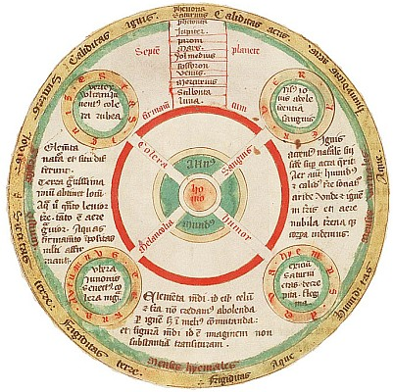
…and one medieval:
both diagrams are from http://medievalscience.blogspot.com/2013/02/medieval-medicine-four-humours.html

Slide 9
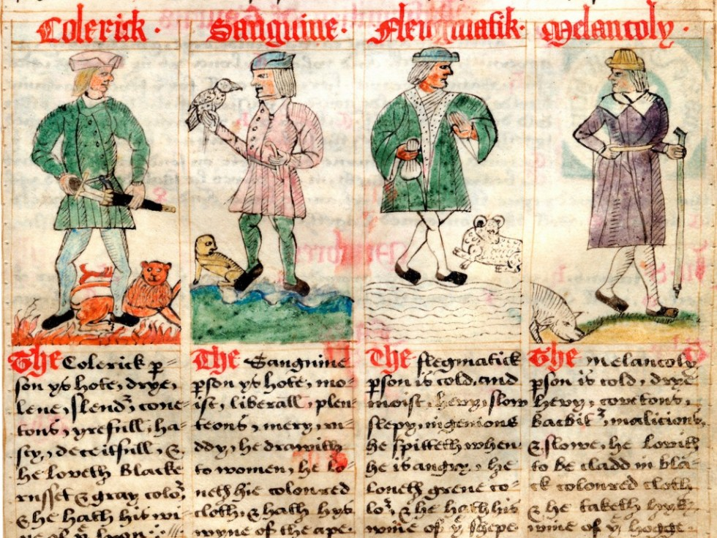
The Four Humors from the collection of the Ritman Library: Bibliotheca Philosophica Hermetica. This text describes a person whose personality is dominated by each of these humors.
Notes:
http://www.ritmanlibrary.com/2012/10/alchemy-the-art-of-change/ppt_i3_4humours/

Slide 10
The text is in English.
Just for fun, see if you can read any of it
Colerick
The Colerick per-
son is hot and dry and
lene and slender, cont-
ent, cheerful; ha-
sty, deceitfull, and
he loveth black,
russet and gray, colors
and he hath his…
Choleric
The Choleric person is hot and dry and lean and slender, content, cheerful, hasty, deceitful, and he loves black, russet and gray colors and he has his…

Slide 11
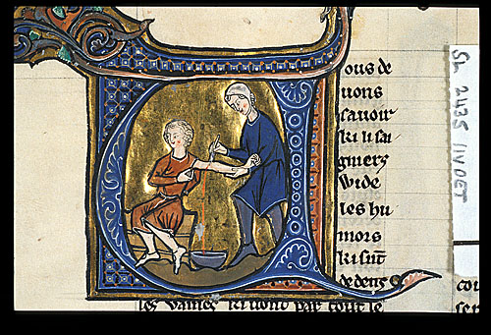
Balancing the Humors
Medieval physicians believed that no one’s humors were perfectly balanced.
  One was born with one humor dominant.
  Slight imbalances resulted in different physical appearances and personalities.
Serious imbalances caused disease.
The medical practitioner’s job was to rebalance the humors.
  This could require behavior modification—changes in diet, exercise, living conditions etc.
  It could also require medical intervention such as medicine or a purge.
Medieval Note: Bloodletting or phlebotomy served to rebalance the humors by removing excess blood. It was a common medieval treatment for disease but also recommended on a regular basis to maintain health (the way someone today might take vitamins).
Bloodletting was often done by barbers or another non-university trained medical practitioner, as you see in this British Library image from France, created in the late 1200s.

Slide 12
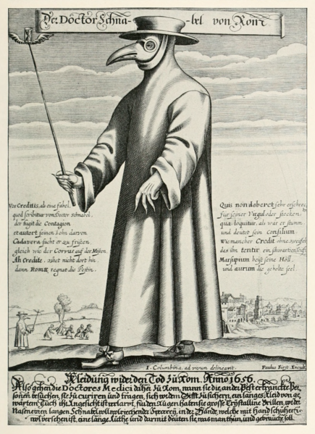
Miasma/ Poison Theory
Miasma is poisonous vapor.
It came from people, animals, and bad-smelling things (like garbage)
It was believed to cause disease if you inhaled it.
Miasma can be seen as separate from humoral theory, but the two were not seen as contradictory.
Images of plague doctors with scary looking masks filled with sweet herbs are common. Doctors did wear these outfits, but not until the mid 1600s, as in this image of a Roman plague doctor from 1656.
Notes:
http://en.wikipedia.org/wiki/File:Paul_Fürst,_Der_Doctor_Schnabel_von_Rom_(Holländer_version).png

Slide 13
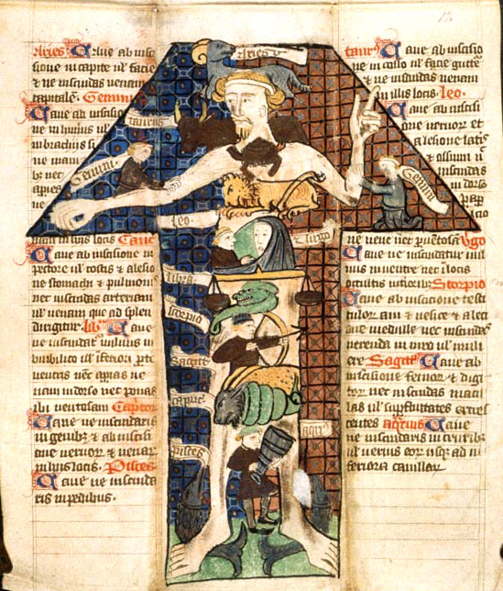
Astrology
Astrology was also absolutely compatible with both medicine and theology in the Middle Ages.
What stars a person was born under influence what humors will be strong in him/her, and what diseases he/she is prone to.
Astrological events can also influence or predict events on earth, including disease.
Zodiac illustration from a medical text written in 1399, now at the British Library
Medeival Note: Most medieval rulers, including popes, employed astrologers as part of their court.
Notes:
http://www.bl.uk/learning/images/bodies/large2270.html

Slide 14
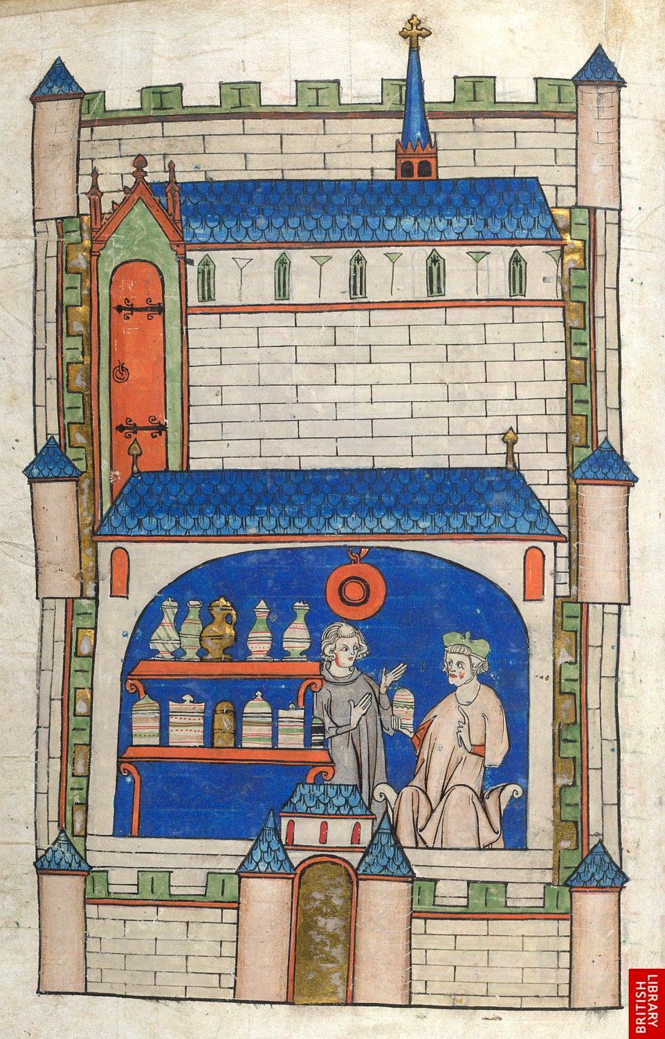
Theory and Practice
Physicians studied medical theory at universities and were the most respected (and expensive) medical practitioners. They worked as advisors, not touching patients themselves (that was seen as beneath them).
Surgeons might have some university training or train under someone else. They actually touched patients.
Priests had no medical training (although some monks and nuns did) but were respected members of the community. People therefore turned to them for advice.
Barbers-surgeons and apothecaries would train as apprentices and dispense medical advice and treatment at lower cost. Most were part of a formal guild that regulated quality and education.
Midwives also trained with experienced older women. They could not form guilds and were seen as the lowest practitioners, largely because of their gender.
Knowledgeable friends, family, neighbors. As today, the first people you might go to for medical advice were experienced people around you.
Apothecary shop, c. 1300
Notes:
http://www.bl.uk/learning/images/medieval/towns/large14512.html

